Slide 1
EVENT MANAGEMENT SYSTEM
2410030138 – KYASA GOWTHAM
2410030188 – ANISH JADHAV
2410030320 – VENKATA MUKESH
2410030496 – P.KARTHIKEYAN
2410030250 – G. KISHORE

Slide 2

OUTPUT

Slide 3

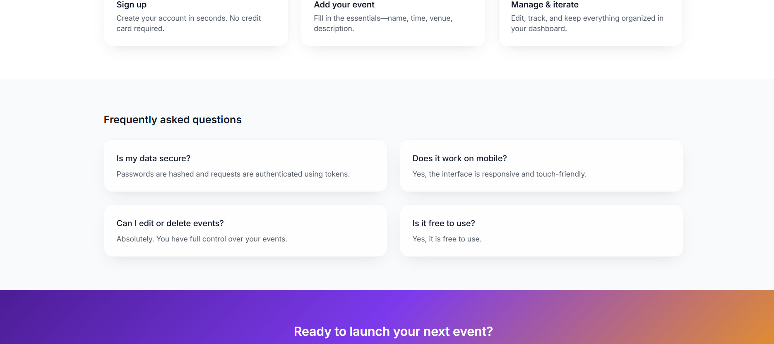
AboutUs

Slide 4
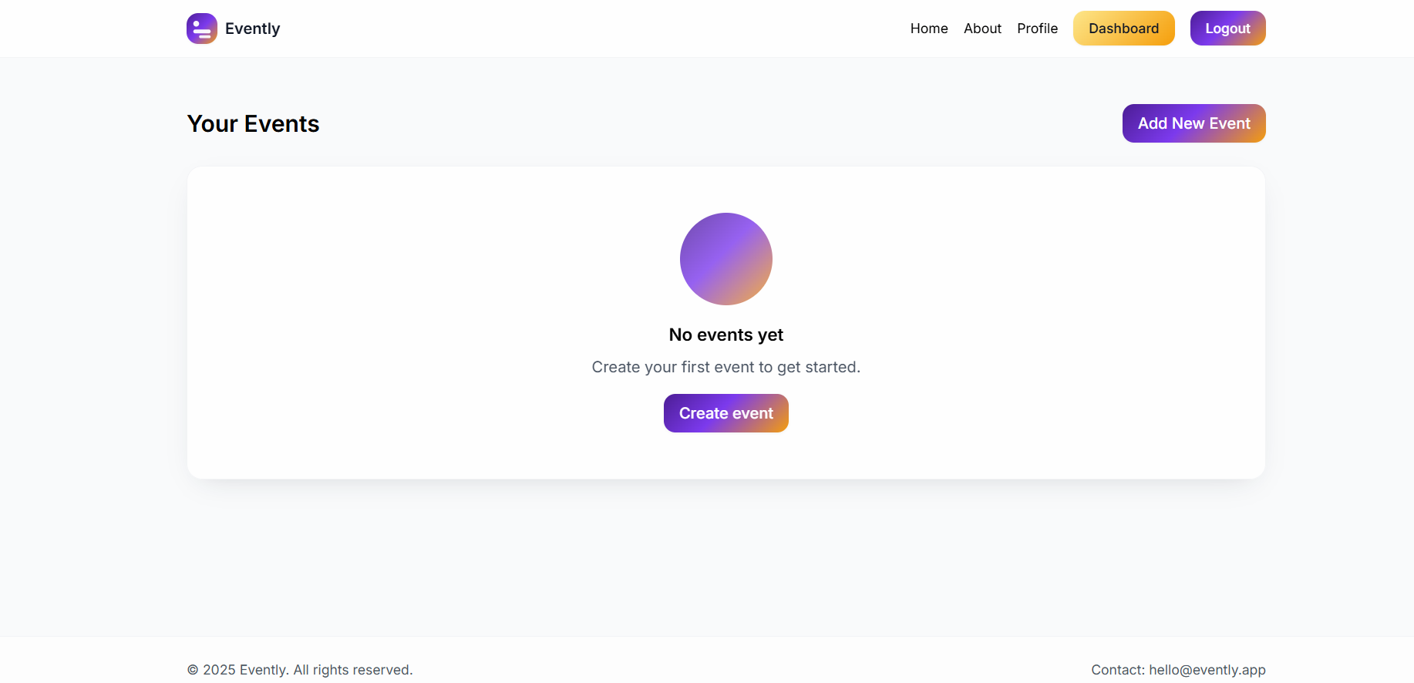
DASHBOARD

Slide 5
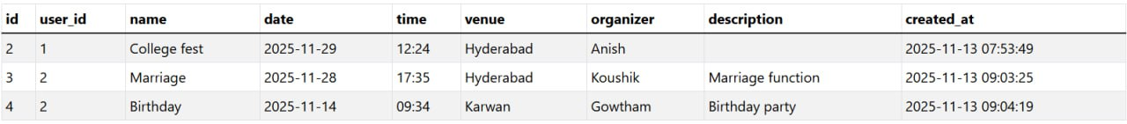
DATABASE

